Slide 1
C.3 Ransomware Analysis – Oct 19 (ICS3C0)
Agenda
Case Study C.3 Ransomware Analysis
Begin Today / Complete For Homework
Mark Spreadsheet
Catch-Up / Fill in those Blanks!
Upcoming
Monday: Virus Presentations

Slide 2
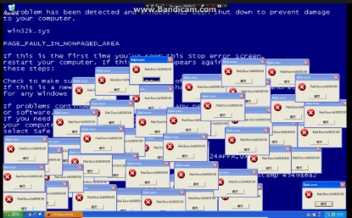
Computer Virus – 1980s /1990s
Method: Disk Based
Transmitted by sharing “infected” floppy disks (or USB memory stick)
Objective
Cause Mischief
Bragging Rights
Effects
Crash Computer
Corrupt Your Data And Programs
Print a funny message to your screen

Slide 3

Computer Virus – 2000s
Method: Email Based / Web Based
Transmitted by “infected” emails
Transmitted by “hacked” web sites
Objective
Trick You into “clicking” on the virus software
Effects
Hack your computer
Steal your “contacts” list
Loss of personal (Financial) information
Financial Scams

Slide 4
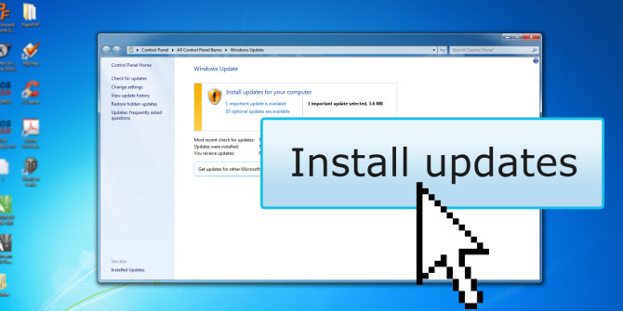
Computer Virus – 2010s
Method: Network Based
Direct Attack on your PC/Device through your Internet Connection
Defeat the “Firewall” Software on your PC / Device.
Objective
To exploit the software vulnerabilities of Operating System & Programs
To keep ahead of the security fixes provided by Microsoft / Apple / Android
Effects
Hack your computer
Steal your “contacts” list
Loss of personal (Financial) information
Financial Scams

Slide 5
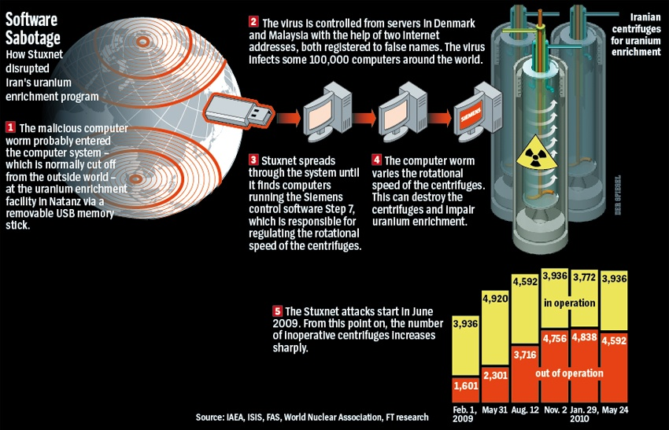
Government “Worms”
Method: Network Based
Direct Attack on Government Network
Objective
Steal state secrets
Military info
Damage Systems
Destroy Equipment
Effects
Espionage
Interfere with Government Projects (Elections)
SUXTNET Worm

Slide 6
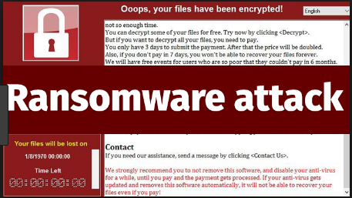

Ransomware
Method:
?
Objective:
Invade you PC / Network
Encrypt (Disable) Important Data
Hold Data for “Ransom”
Effects:
?

Slide 7
Mod B.4 Student Database – Oct 19 (ICS4C0)
Agenda
Code Integration
Daniel’s Part
Kiran’s Part
Presentations
Revise Presentations Based on Feedback
Share Revisions With Mr. Nestor
Upcoming
Monday: Continue Integration of Student Code

Slide 8
4C – Java Code Repository
One Person – Create a Shared Repository
Give the 4C team Write Privileges
Everybody Else – Upload
Upload your Java Class Code to the repository
Everybody Else – Download
Download everyone's Java Class Code to your Eclipse project.

